Slide 1
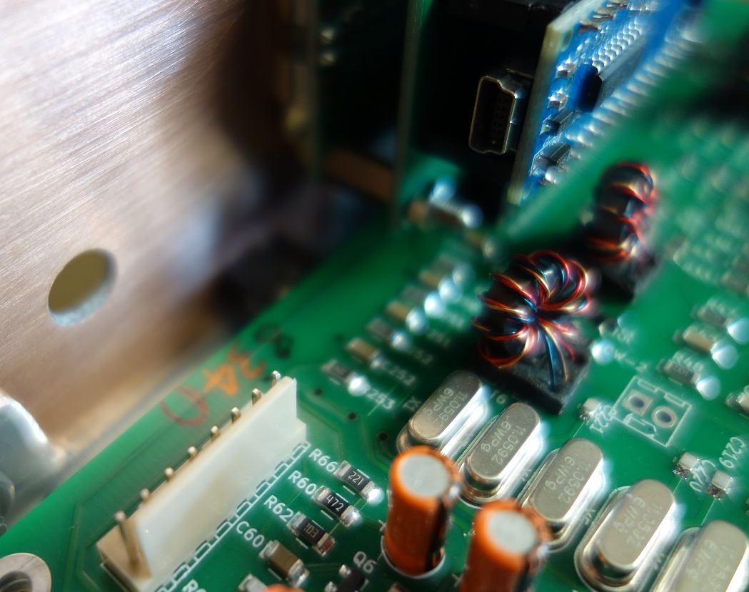
uBitx – HF Transceiver Semi-kit
Presented to the Lake Washington Ham Club
www.lakewashingtonhamclub.org
March 2020
Roman Mach K7TXL

Slide 2
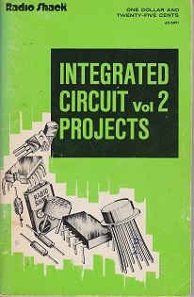
My Background
Licensed ham for one year; currently General
MSEE/Software developer
Learned to solder at age 13. Inspired early on by Forrest M. Mims III’s “Integrated Circuit Projects”
Then computers came along, and didn’t go down the ham path
So crash coursed into ham radio in 12 months

Slide 3
The HF Problem
The cost to outfit a decent shack is $1000 *
Can we bring that cost down without affecting quality? Yes, mostly.
* The Budget $1000 Ham Shack (Ham Radio Crash Course)
https://www.youtube.com/watch?v=VOGaFW440KY

Slide 4
Other Issues!
The solar minimum has closed bands, should I just wait a few years?
HF sounds too complicated, what can I do?
I’m a Technician and dabbled with VHF – why should I bother with HF, especially since I’ll probably need to upgrade to General?
I’m not going to address these directly, rather I am going to show how to do a lot with a little.

Slide 5
One solution...
We must be willing to…
Have lower output power
Roll up our sleeves and do a little soldering and assembly
This is where the uBitx comes in…

Slide 6
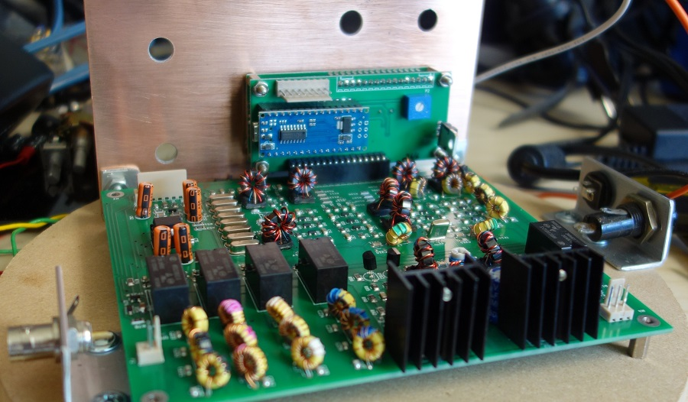
The uBitx: A full-featured transceiver “semi-kit”
An inexpensive way to get into all-band HF communication
Currently $150 for the kit, shipped from India
You get a fully tested main board and a bag of external parts. “Some assembly required”
Digital tuning and sensitive analog receiver
10W “QRP” SSB, CW and digital
FT-8 is possible if you connect a computer’s USB and audio and run software like WSJT-X

Slide 7
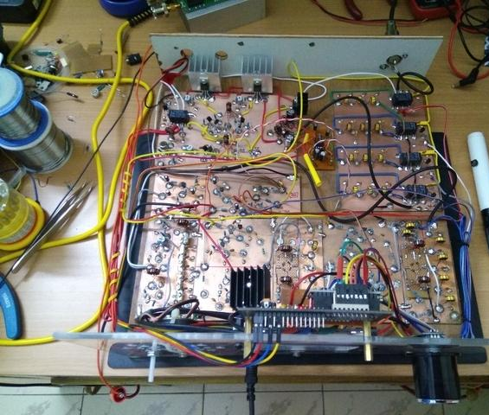
Some History…
The design concepts started in the QRP homebrew movement
VU3JVX scratch-built v6 uBitx shown on the right *
Ashhar Farhan VU2ESE, an Indian homebrewer, designed the single band BITX40 and most recently the uBitx.
Note: Only versions 5 or above are considered usable in the US without hardware modification
Alternate firmware by KD8CEC for TFT touchscreen support
ARRL QST magazine product review in September 2019 issue
Version 6, the first version to include a TFT display shipped recently
You can also buy a full parts kit option (case, speaker, etc.) for $50 more
* http://soldersmoke.blogspot.com/2019/12/vu3jvxs-beautiful-homebrew-scratch.html

Slide 8
Limitations
AGC (Automatic Gain Control): There is none! Not ideal for nets or certain communication scenarios. Usually not a problem for digital modes
Kit-projects.com has an AGC add-in board for $15 (minor soldering required)
CALIBRATION: Some units require frequency calibration. Not an intuitive process
See groups.io BITX20 group for ideas
SPECIFIED @ 12 VOLTS
QST tested at 13.8 with no problems, but I use two dropping diodes with my LiFePO4 battery

Slide 9
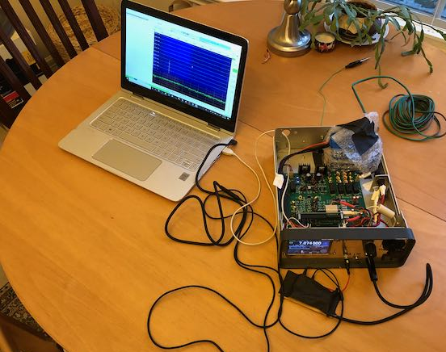
How cheap can we go? Receive-only for $200
You probably already have a computer
Build it without a case?
Need some cables for audio and USB
Need a piece of wire for antenna, use indoors
Disable TX in the config
Ok, you’ll need a soldering iron and solder, but that could be borrowed
Power? 1A 12V wall warts everywhere *
*Or use this trick: Run the receiver off USB 5V – it works!
Should I do it? Probably not.

Slide 10
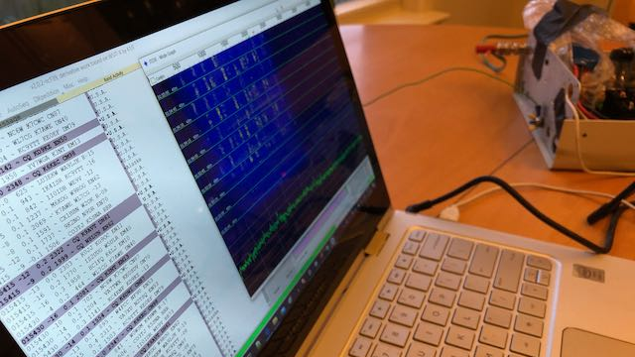
30’ indoor wire antenna picks up Alaska on FT-8
(Use receive-only!)

Slide 11
I’m willing to spend more so I can transmit!
A case and a speaker (internal or external)
Battery or clean 12-13.8v power supply (3A minimum recommended)
Coax with connectors (BNC on uBitx end)
50 ohm, 10W dummy load (easy to make with carbon resistors)
Antenna with cable into shack; choke balun as required

Slide 12
Useful extras
A case for the mic and switch (find 3D-printed tiny cases online)
For digital modes:
Computer
USB cable for rig control
Cable sound adapter (Usually a pair of stereo cables, 1/8” plug on each end)
SDR for better calibration; Alternative: Accurate signal generator/frequency counter

Slide 13
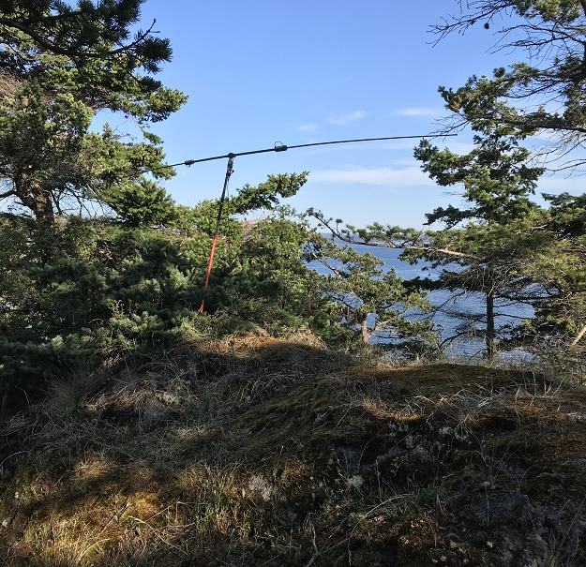
Steps to get on the air
Order uBitx (DHL is nice since it is faster shipping)
Order a uBitx case (recommended)
Assemble uBitx parts into the case
Connect to power
Attach antenna cable and calibrate if needed. Check receive operation.
Attach a dummy load and power meter and key the mic or CW key to confirm output
Communicate on your authorized frequencies

Slide 14
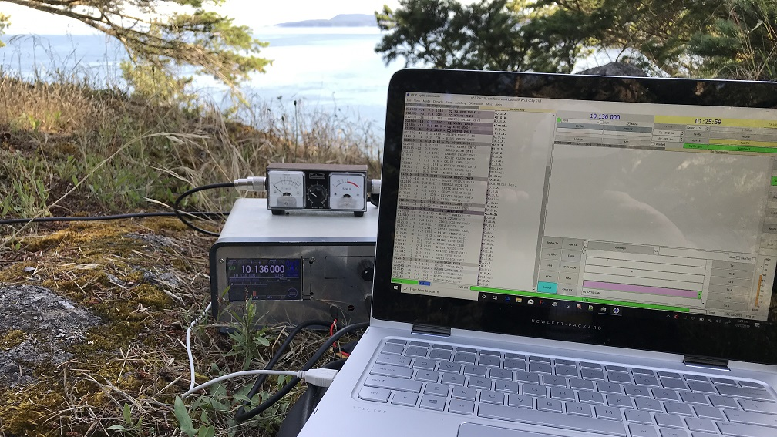

Slide 15
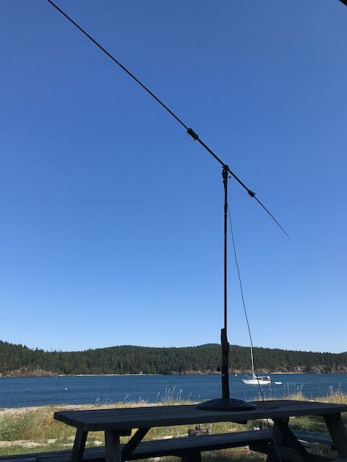
Get on the air with digital modes
Install WSJT-X on computer
Install software to sync computer to atomic time
Connect USB cable from computer to Raduino
Configure CAT control and confirm that WSJT-X commands frequency changes on uBitx display
Connect audio cables from computer to uBitx
Select a band through WSJT-X and check signal level display: You should start seeing FT-8 decodes appearing on the WSJT-X waterfall
Read the docs on FT-8 QSO
Get on the air!

Slide 16
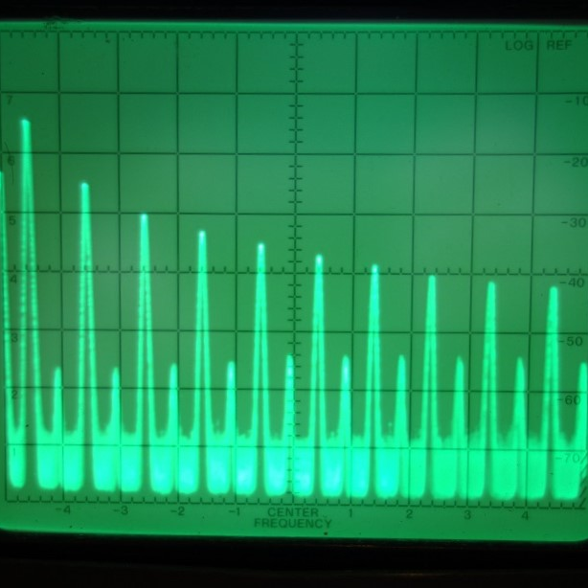
Calibration tips
Set calibration mode, tune in WWV, and adjust for zero beat
Then set BFO so that audio is right in the crystal filter bandwidth (can be tricky – a video shows how to use a web-based audio spectrum analyzer)
But be careful not to tune to the (reverse) image otherwise LSB and USB will be reversed
Other techniques get more sophisticated from there, requiring an SDR or signal generator and frequency counter

Slide 17
Is it right for me?
Need a cheap digital mode multiband transceiver with CAT control
I like to experiment with electronics
I have some kit building experience
I just want to do shortwave listening
This Photo by Unknown Author is licensed under CC BY-SA

Slide 18
Should I pass this one by?
I like to talk up and down the coast on SSB
Don’t know what end of the soldering iron to hold
Where’s the manual?
Where’s phone support?
Where’s the waterfall display?

Slide 19
Resources
groups.io BITX20 group (questions and answers, “help desk”)
ubitx.net (all things uBitx aggregated here)
hfsignals.com (buy your uBitx here)
September 2019 QST review with measured performance
hamskey.com (alternate firmware by KD8CEC)
WSJT-X
JDTX (slightly more user friendly WSJT-X derivative)

Slide 20
Demo

