Slide 1
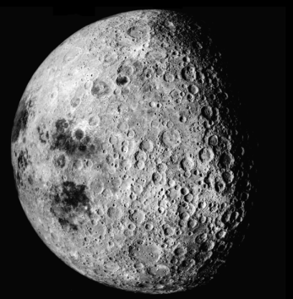
Why ‘ham radio’? Do you like . . .
Scouting or high adventure wilderness hiking? Radio is a great way for groups to keep in touch with each other. Cell phones have a limited range close to home and no coverage in the wilderness.
Talking to people all over the world? With Skywave propagation, the world is open via your radio. There are over 2 million licensed ham radio operators that are looking for you . . .
Competition? Hams have very competitive events called “Contests” where you get points for the number of contacts made.
Helping with events and meeting interesting people? Hams help at the Seattle Marathon, the Flying Wheels Summer Century
100-mile bicycle ride, the Seafair Parade and other public events.
Disaster preparedness? Electricity fails, cell phones don’t work, no one knows what to do, where do you turn? Answer: Ham radio
Our motto: “When All Else Fails . . . Amateur Radio”
Space Science and Astronomy? Contact other hams
using satellites; talk to the ISS Space Station; or EME
“Moon Bounce!”
STEM subjects? Radio is all about science and engineering: applied math, electronics, physics, etc. Supports SAT and ASVAP tests.
A great add on college applications. Your next science fair project?
Building things? Building and playing with antennas is a very fun ham radio activity. You get to play with wire high up in the air! ☺
Computers and software? “Software Defined Radio”(SDR) is an important topic in Radio right now. 99% of all radio work can now be done in software. Many high-end and military radios are SDRs with built-in computers.
Other technical interests? Think about adding Radio
as a component to your project! Control robots and
other devices wirelessly, such as model airplanes,
helicopters. Track high altitude balloons.
(Turn over for next steps and a list of resources available to you!)

Slide 2
This sounds interesting . . .
How do I get more information?
Next Steps
  Amateur Radio Relay League (ARRL)
  http://www.arrl.org/what-is-ham-radio
  Find a local club
  http://www.lakewashingtonhamclub.org/
  http://www.arrl.org/clubs (find your own local club)
  Study and get your ham license – your ham license is like a driver’s license: it lets you get started driving your radio! ☺
  http://www.arrl.org/courses-training
  http://www.lakewashingtonhamclub.org/?page_id=145
Resources
  http://www.twit.tv/show/ham-nation (an excellent, long-running
  podcast on ham radio)
  http://www.facebook.com/yarphams (Youth in Amateur Radio Podcast)
  http://www.tedrandall.com/ (another long-running podcast)
  The BSA offers three merit badges that are very related to ham radio and technology: Electricity, Electronics and Radio. If you are a scout,
  it is a great way of getting started.
Books and magazines:
  ARRL’s QST magazine, part of your membership – world-class information and the best ads from radio manufacturers – great reading and browsing ☺
  CQ Magazine http://www.cq-amateur-radio.com/
  Ham Radio for Dummies, by H. Ward Silver: a *great* book for perspective new hams – it covers the entire hobby)
  ARRL’s licensing manuals: Technician Class license
  http://www.arrl.org/shop/Ham-Radio-License-Manual-Revised-2nd-Edition/
  FCC licensing books by Gordon West (Technician, General and Extra classes)
  Check them out on Amazon.com – The Best of the Best!
  http://hamradioschool.com/ ran by Stu Turner has a lot of excellent ‘Getting Started’ material
(Turn over for some ideas on why ham radio might interest you!)

